Slide 1
Company Profile

Slide 2
About Us
SRI SATHYA SAI TOURISTS (R) more known as SST was established in 1968 by LATE SRI. NARAYANA BHATTA, B.A., L.L.B. (HON) a leading advocate as a proprietorship concern. SST is now a partnership firm with three partners:
Mr. S N Krishna Chidambara B.E. (Civil) – CEO & Partner
Mrs. Geetha Chidambara M.Sc. (Physics) – CFO & Partner
Mr. Pramod B.E (E & E) – Partner
1968
Sri Sathya Sai Tourists was established by Late. Narayana Bhatta.
1993
SST registered as partnership firm
1998
Employee transport services started.
OUR MISSION
“WE MAKE TRAVEL A PLEASURE”
2011
Student transport services started.

Slide 3
Hierarchy
CEO
CFO
Finance Manager
Manager – ABS
Manager Maintenance
Manager
Corporate Travels
Manager Sales & Marketing
Manager Leisure Travels
H R Executive
Asst Manager Accounts
Asst Manager Billing
Executive
Maintenance
Asst Manager Corporate Travels
Asst Manager Accommodation
Asst Manager Ticketing
Asst Manager Leisure Travels
Executives
Accounts
Executives
Billing
Mechanics & Drivers
Operation Executive
Executive
Sales
Executive
Sales
Executive
Sales
Site In-Charge
Shift in charge
Supervisors

Slide 4
Services
Student Transportation
Staff Transportation
Services
Ticketing & Foreign Exchange
Leisure Tours
Accommodation

Slide 5
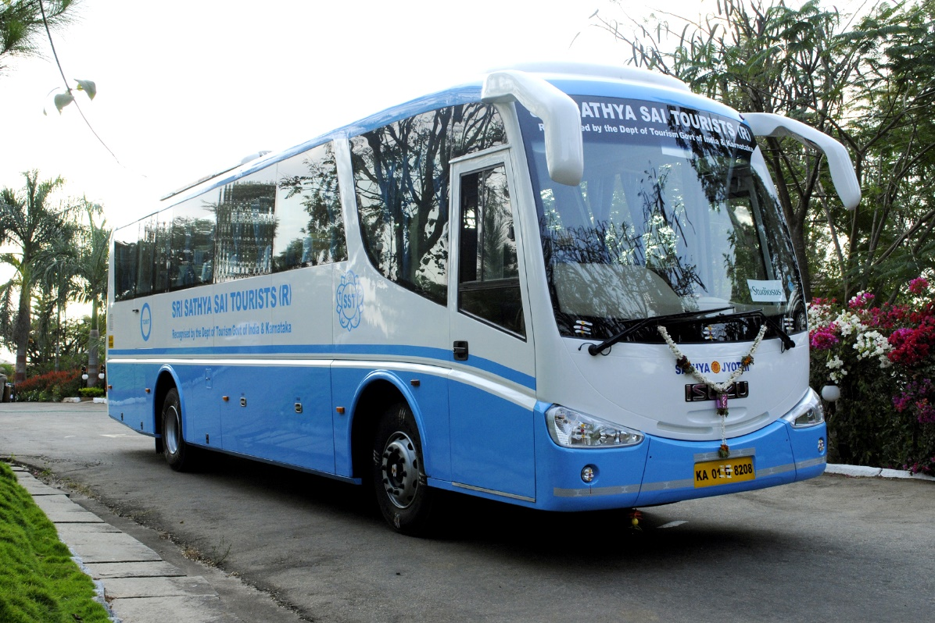
Leisure Travel
We provide the best in the class vehicles ranging from 4 seater to 50 seater vehicles with A/C and non A/C segment, for all desired local or outstation trips.
Vehicles are provided with our most sophisticated modern coaches and cabs with well groomed chauffer's to travel to any destination of your choice.
SST is pioneer in travel industry providing the best hospitality and unmatched services to our customers since 5 decades. We ensure utmost care taken with the quality of vehicle and satisfaction of our loved customers.

Slide 6
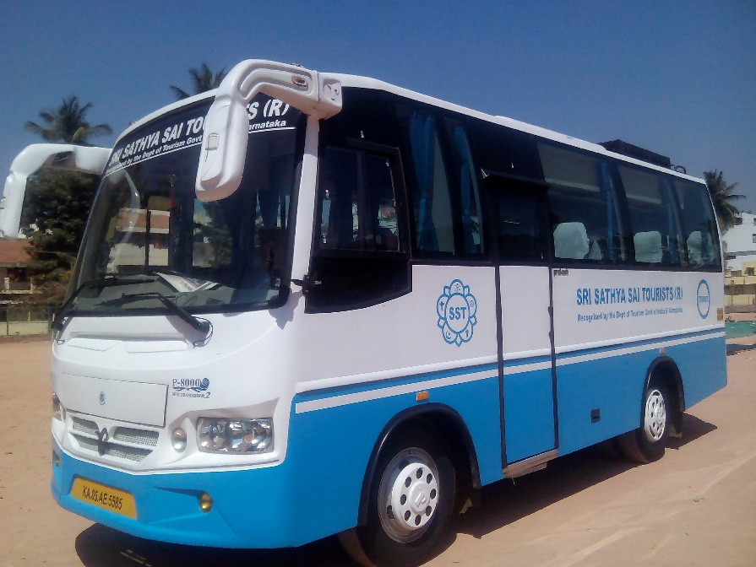
Staff Transportation
SST is engaged in providing dedicated transport facility to the corporate sector for the commutation of their employees on a 24 X 7 basis.
We operate over 1000 vehicles on 24/7 basis to cater to the business requirement of our esteemed clients located in various parts of Bengaluru city. Transportation is provided to all major Software, BPO & Manufacturing companies.
We provide vehicles ranging from 4 seater to 50 seater with A/C and non A/C segment which includes Indica, Sumo, Xylo, Swift, Etios, Innova, T T, Mazda & buses, integrated with latest GPS technology to track & monitor vehicles movement and routing applications, keeping safety and security of all employees, especially female employees as top priority.
We ensure that integrity and transparency of data management are captured accurately with right information as per client requirement.

Slide 7
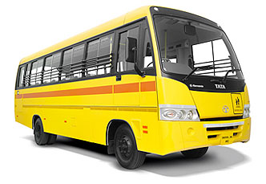
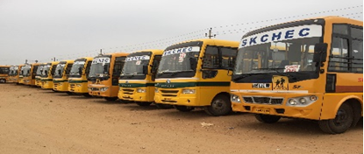
Student Transportation
We provide dedicated vehicles to Schools and Colleges in Bengaluru city. Presently we are operating over 110 buses at Sri Kumaran’s School, BASE College, JSS College, GR School and few more reputed institutions.
We leave no stone unturned to make sure your kids have a comfortable journey to and from school. All our school operating vehicles are fitted with state of art technology enabled GPS devices to track and monitor vehicle movement and ensure timely arrival and departure.
Our on-ground staff handling children are given special training to take care of the safety of the children and make them comfortable
Our Children are our future. We take that extra care to ensure each child commutes safely and comfortably.

Slide 8
Accommodation
We provide customized and tailor made packages as per customer choice. We provide wide variety of packages to all popular destinations in all budgets.
Accommodation arranged as per customer choice i.e., Deluxe hotels, Budget hotels, Resorts, Beach side hotels, Cottages, Home stay's and Dormitory.
Our highly trained staff will assist you in designing your package and make your holiday memorable.
Campfire, Games and other Entertainment programs can be arranged during the tour.
We assist in vehicle booking for sight seeing at the desired destinations.

Slide 9
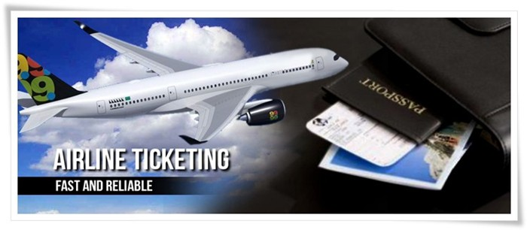
Ticketing
We assist customers in booking Train & Bus tickets to all destinations.
We provide tickets for package tours conducted by KSTDC, APTDC, ITDC and other tour operators.
Booking of Air & Cruise Ticketing - Domestic & International.
Assistance In Visa.
Assistance In Foreign Exchange.
Assistance in Travel Insurance.

Slide 10
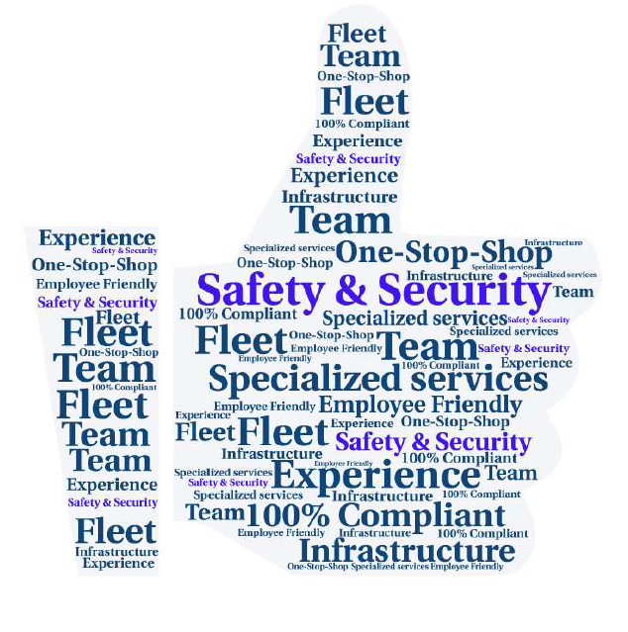
Our Strengths
Our Mission - We Make Travel A Pleasure.
Head Office: Centrally located in Bangalore.
Infra Structure: We have well trained and experienced staff on operations, administration, including drivers & mechanics.
Service: We have well equipped 3 garages located at different locations.
Specialized Service : We give night service for women drop in night with Escorts.
Cost: Very competitive price & in line with market rates.
Safety: Well trained and groomed drivers with fully equipped safety devices like GPS, CCTV, mobiles, log book and dedicated staff.
GPS Control Room: Centralized GPS tracking at ITPL office.
We are technically strong.

Slide 11
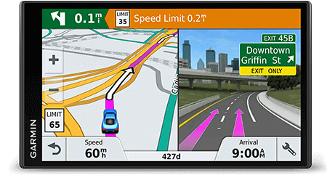
Live Tracking for Safety & Security
In the interest of the passengers on their safety and security, SST has installed General Positioning system ( GPS ) in all our vehicles.
Tracking of vehicles on real time basis using GPS. It provides instant alert on speed violations, fuel pilferage and geo fence violations.
Regular vehicle health checkup is carried at our garages, with advanced equipment's by highly skilled technicians.
GPS & routing algorithm enhances the safety of all employees during transit by intelligent routing and helps in route & cab optimization.
Driver and staff screening including police verification.
Monitoring speed limits while commuting.
Buses Fitted With GPS, CCTV, Mobile, Log Book & Electronic Display Board.

Slide 12
Training
SST conducts regular training to our ground staff and drivers on lane discipline, behavior and safety aspects, etc.,
Training provided to lady attendants on board to take care of safety of each child, follow discipline and hygiene.
Vehicle upkeep by preventive maintenance, compliance with govt. regulations, vehicle incident logs.
All our drivers are periodically trained, educated on safety measures.

Slide 13
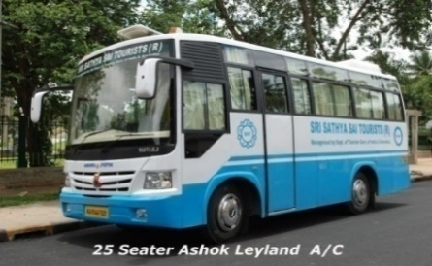
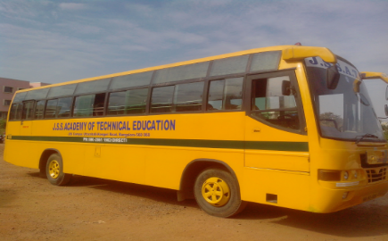
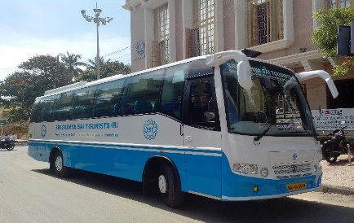
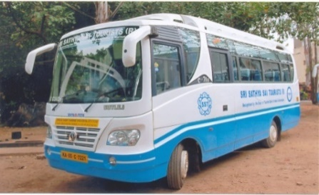
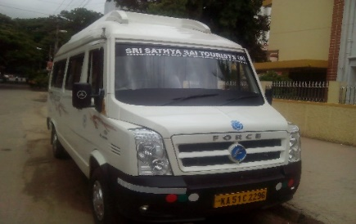
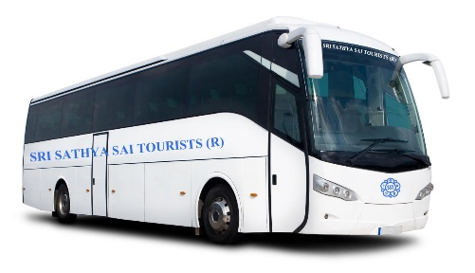
Fleet
The company owns and operates over 1000 vehicles including Leased / Outsourced vehicles. The Company Provides : Both A/c & Non A/c Coaches are in the seating capacity of 4,5,9,12,18,27,32,35,50 with latest designs, tailor made with Reclining Seats, Seat Cover, Window Curtains, Ice Box, P.A Systems, Audio & Video Systems & Eye Pleasing Interiors.
The Vehicles Include Tata Indica, Indigo, Swift Desire, Toyota Etios, Carolla Altis, Camry, Benz, BMW, Toyota Innova, Innova Crysta, Tempo Traveler, Mazda, Ashok Leyland Mini & Bigger A/C & Non A/C Coaches.

Slide 14
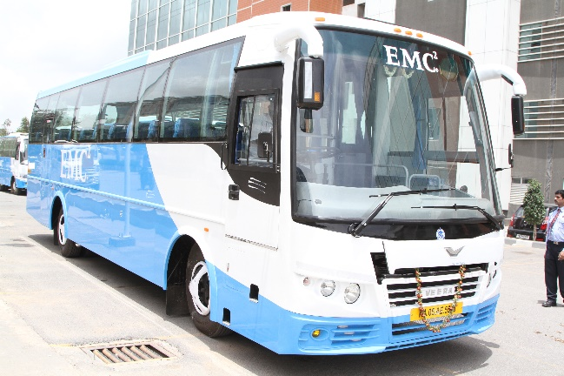
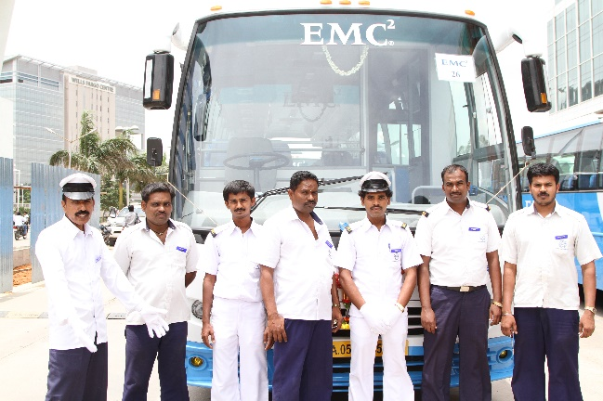
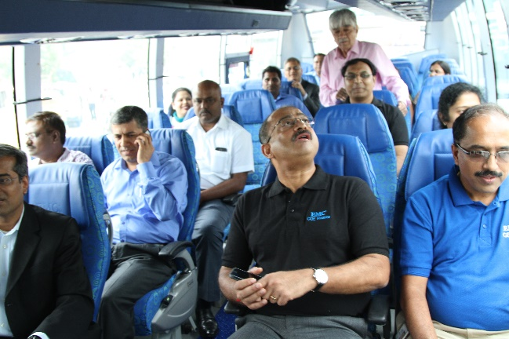
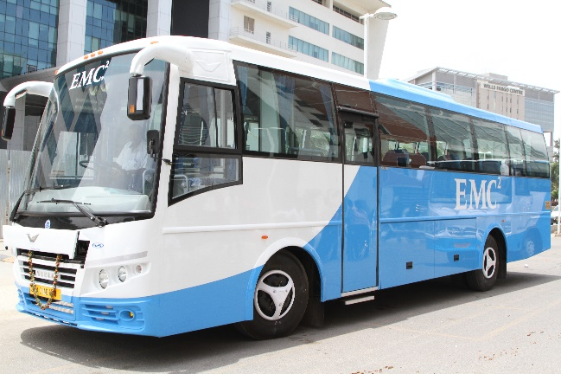
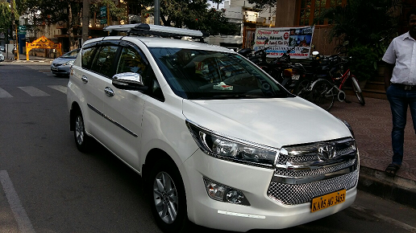
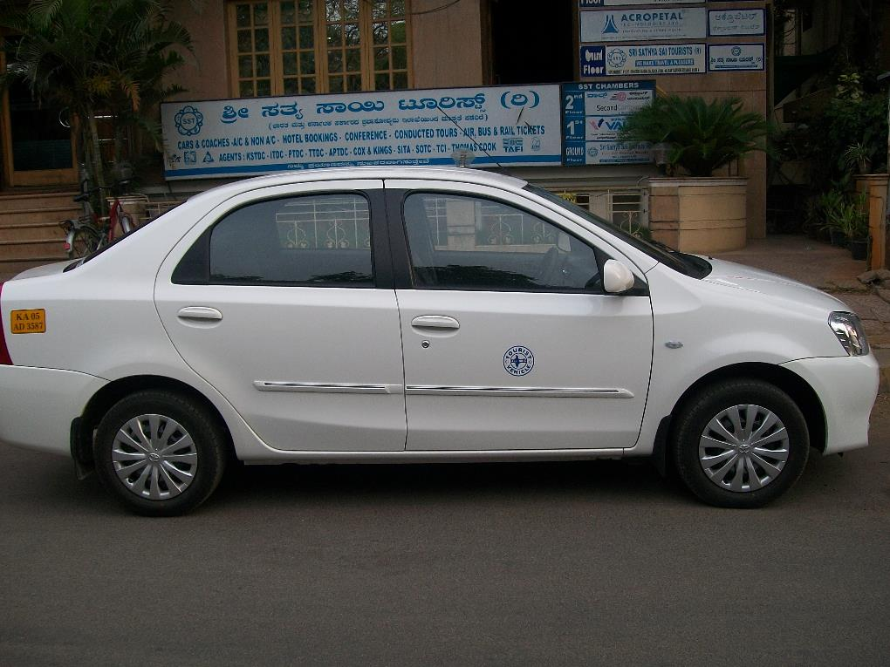
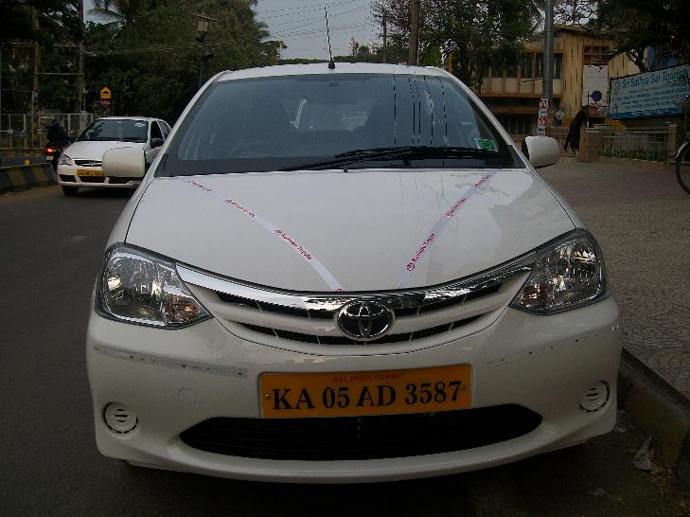
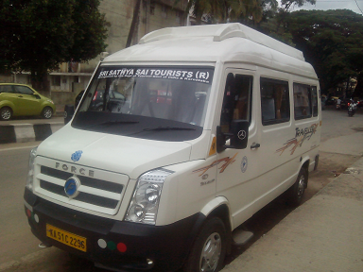
Vehicles of Staff Transportation

Slide 15
Our Clientele

Slide 16
Our Clientele
And Many More Companies

Slide 17
Recognitions and Memberships
We are recognized by:
Department of Tourism, Government of India
Department of Tourism, Government of Karnataka
We are authorized members of:
Indian Association of Tour Operators (IATO)
Travel Agents Association of India (TAAI)
India Tourist Transporters Association (ITTA)
Bangalore Tourist Taxi Owners Association (BTTOA)
Federation of Karnataka Chamber of Commerce & Industries (FKCCI)
Karnataka Tourism Forum (KTF)
International Air Transport Association (IATA)
We Are Authorized Agents For
India Tourism Development Corporation (ITDC)
Karnataka State Tourism Development Corporation (KSTDC)
Tamil Nadu Tourism Development Corporation (TTDC)
Kerala Tourism Development Corporation (KTDC)
Rajasthan Tourism Development Corporation (RTDC)
Pondicherry Tourism Development Corporation (PTDC)
Andhra Pradesh Tourism Development Corporation (APTDC)
Gujarat Tourism Development Corporation (GTDC)

Slide 18
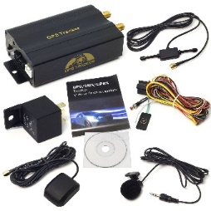
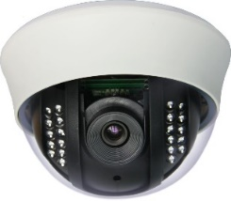
Future Outlook
Keeping in line with our company motto of making travel a pleasure, we are committed to:
Increase our outlook on safety by fitting buses With CCTV, Mobile, electronic log book & electronic display board.
Leverage available technology to better the experience of our costumers.
Helping the environment from our part and adapting to the future by transitioning into electric cars.
Increase fleet size and variety
Recruit more women drivers to maintain equality

Slide 19
Meet the Team
CEO
S N Krishna Chidambara
+91 9845077622
CFO
Geetha Chidambara
+91 9845177622
Manager – Leisure Travels
Jayanthi.B
+91 80956 45645
Manager – Corporate Travels & School Transport
Kushraj Patil
+91 95388 94172
Manager – Marketing & Sales
Rama Prasad A
+91 95388 80999
Manager – Admin, Billing & Statistics
Shivakumar H
+91 88846 02999
Manager – Maintenance
Rajeeva Lochana
+91 88847 71000

Slide 20
Profile Video
Click image to play video

Slide 21
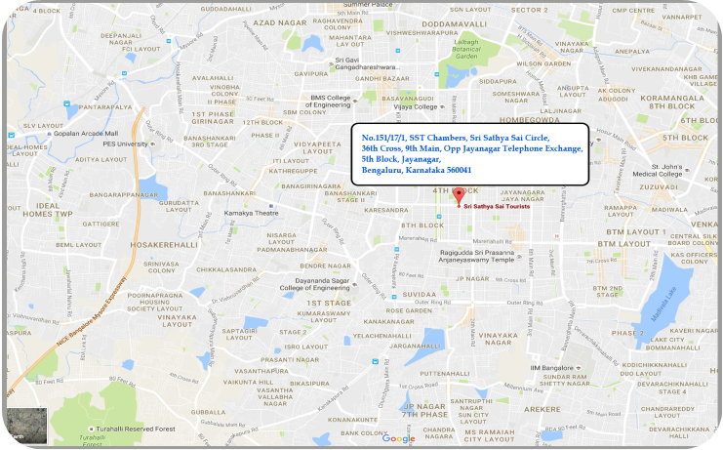
Contact Us
SST Chambers,
No. 151/17/1, 36th Cross,
9th Main, 5th Block Jayanagar,
Bengaluru – 560041
Karnataka, India
+91 80 - 26541140, 40819819
+91 80 - 26649940
ssst@sathyasaitourists.com
Our Head Office operates
between 9 AM to 8.30 PM and we support
24 X 7 assisted by respective departments managers.

Slide 22
Thank You

